Slide 1
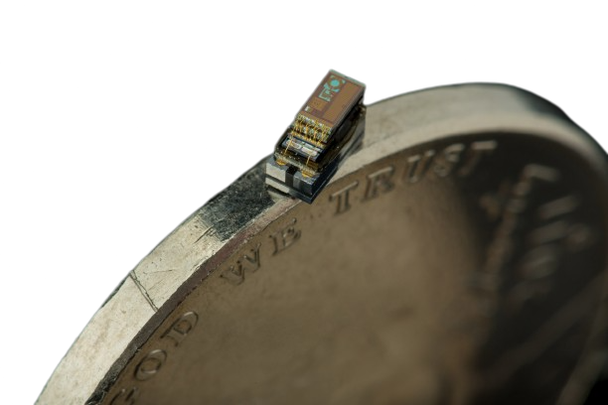
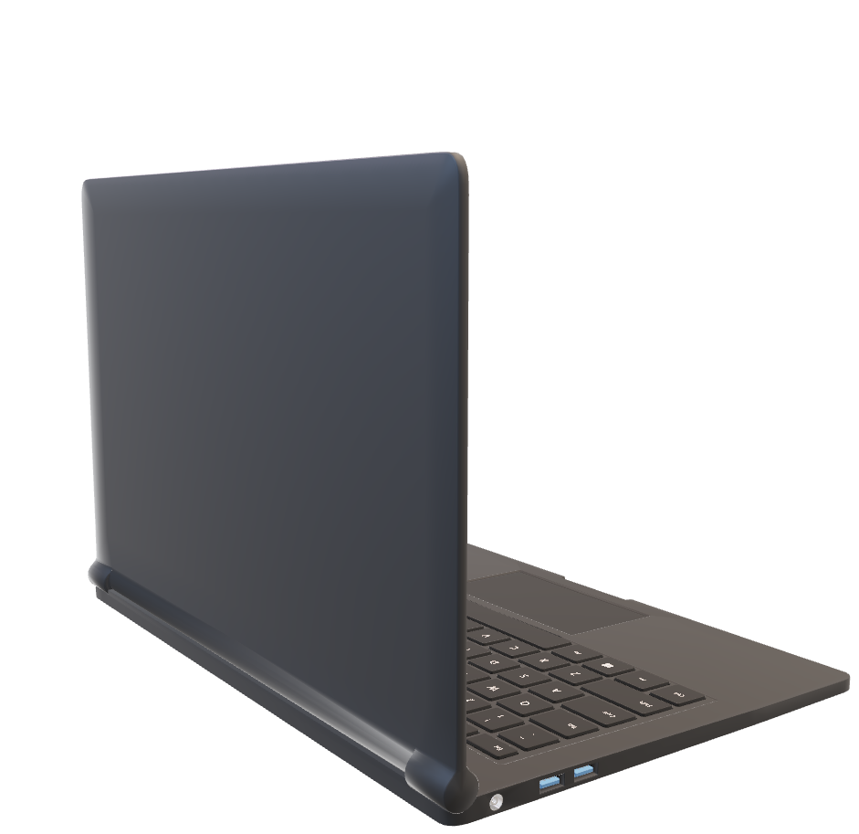
COMPUTER
COMPUTER
COMPUTER
COMPUTER
COMPUTER

Slide 2
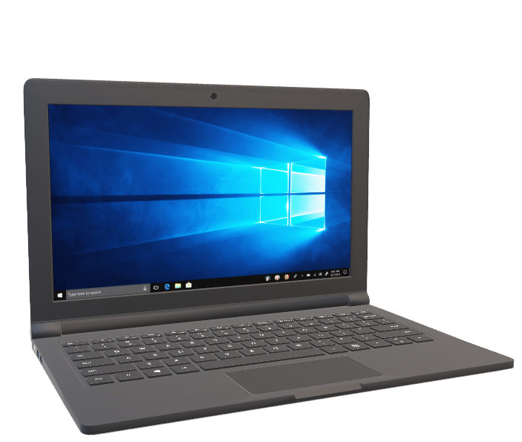
COMPUTER
COMPUTER
COMPUTER
COMPUTER
COMPUTER

Slide 3
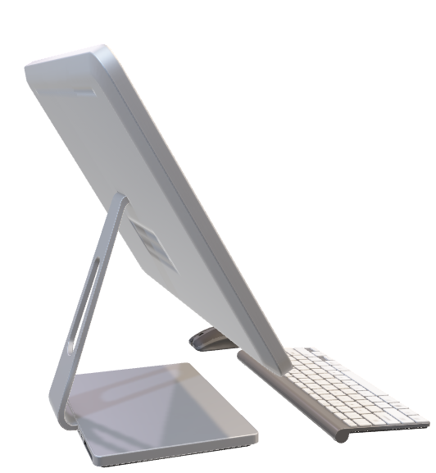
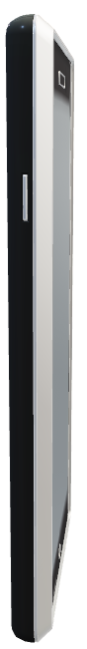
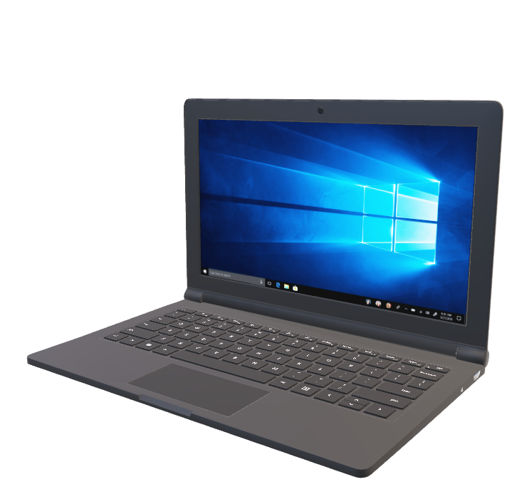
COMPUTER
COMPUTER
COMPUTER
COMPUTER
COMPUTER
WE ALL KNOW WHAT A COMPUTER IS. IT IS AN MACHINE WHICH TAKES RAW DATA, PROCESSES IT AND OUTPUTS THE PROCESSED DATA THROUGH THE HELP OF A OUTPUT DEVICE.

Slide 4
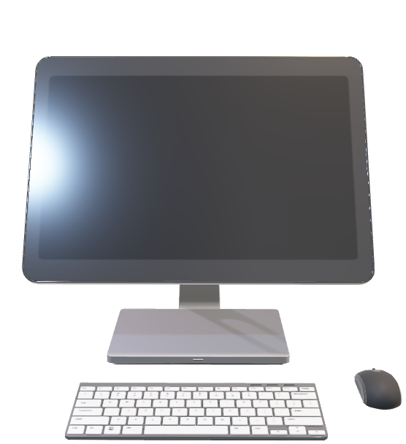
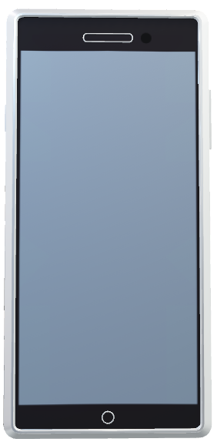
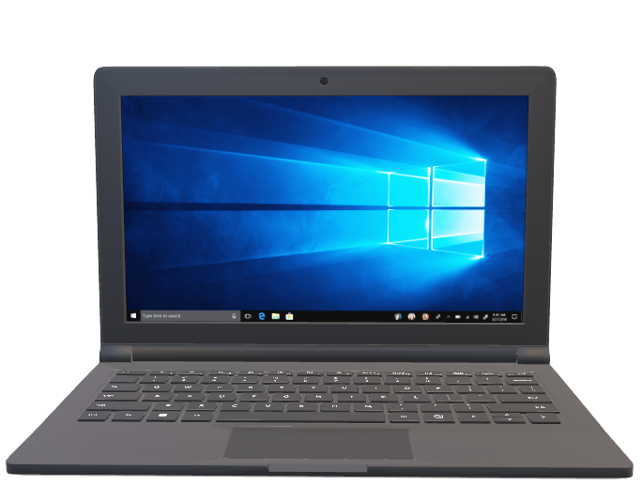
THERE ARE MANY TYPES OF COMPUTERS

Slide 5
THE WORLD’S SMALLEST
COMPUTER
-Presented by Sneha

Slide 6
THE WORLD’S SMALLEST
COMPUTER
The M3 is a microcomputer developed by the University of Michigan, considered to be the world's smallest computer. It measures 0.3 mm on each side and is used in medical implants and other applications where small size and low power consumption are critical.
#uses

Slide 7
THE WORLD’S SMALLEST
COMPUTER
#uses
M3
Medical Implants
Environmental Monitoring
Smart Devices
Security, etc.
coin
#How is it made

Slide 8
THE WORLD’S SMALLEST
COMPUTER
#uses
#How is it made?
M3
It's made from a piece of silicon with very small parts that were created using photolithography, and it has a solar cell to power it. It has many potential uses, especially in areas where space and power are limited.
Medical Implants
Environmental Monitoring
Smart Devices
Security, etc.
coin

Slide 9
THE WORLD’S SMALLEST
COMPUTER
THANK
YOU
#uses
#How is it made?
It's made from a piece of silicon with very small parts that were created using photolithography, and it has a solar cell to power it. It has many potential uses, especially in areas where space and power are limited.
Medical Implants
Environmental Monitoring
Smart Devices
Security, etc.
-Made by Sofan Paudel
M3
coin

